Slide 1
















Entity Linkage in Evolving Temporal Graphs
Data Intensive Systems - 2024
Utrecht University
Group #15
Instructor: Prof. Yannis Velegrakis
Alex Francis
Bar Melinarskiy
Sofia Bianchini
Notes:
We are group #15 ☺

Slide 2
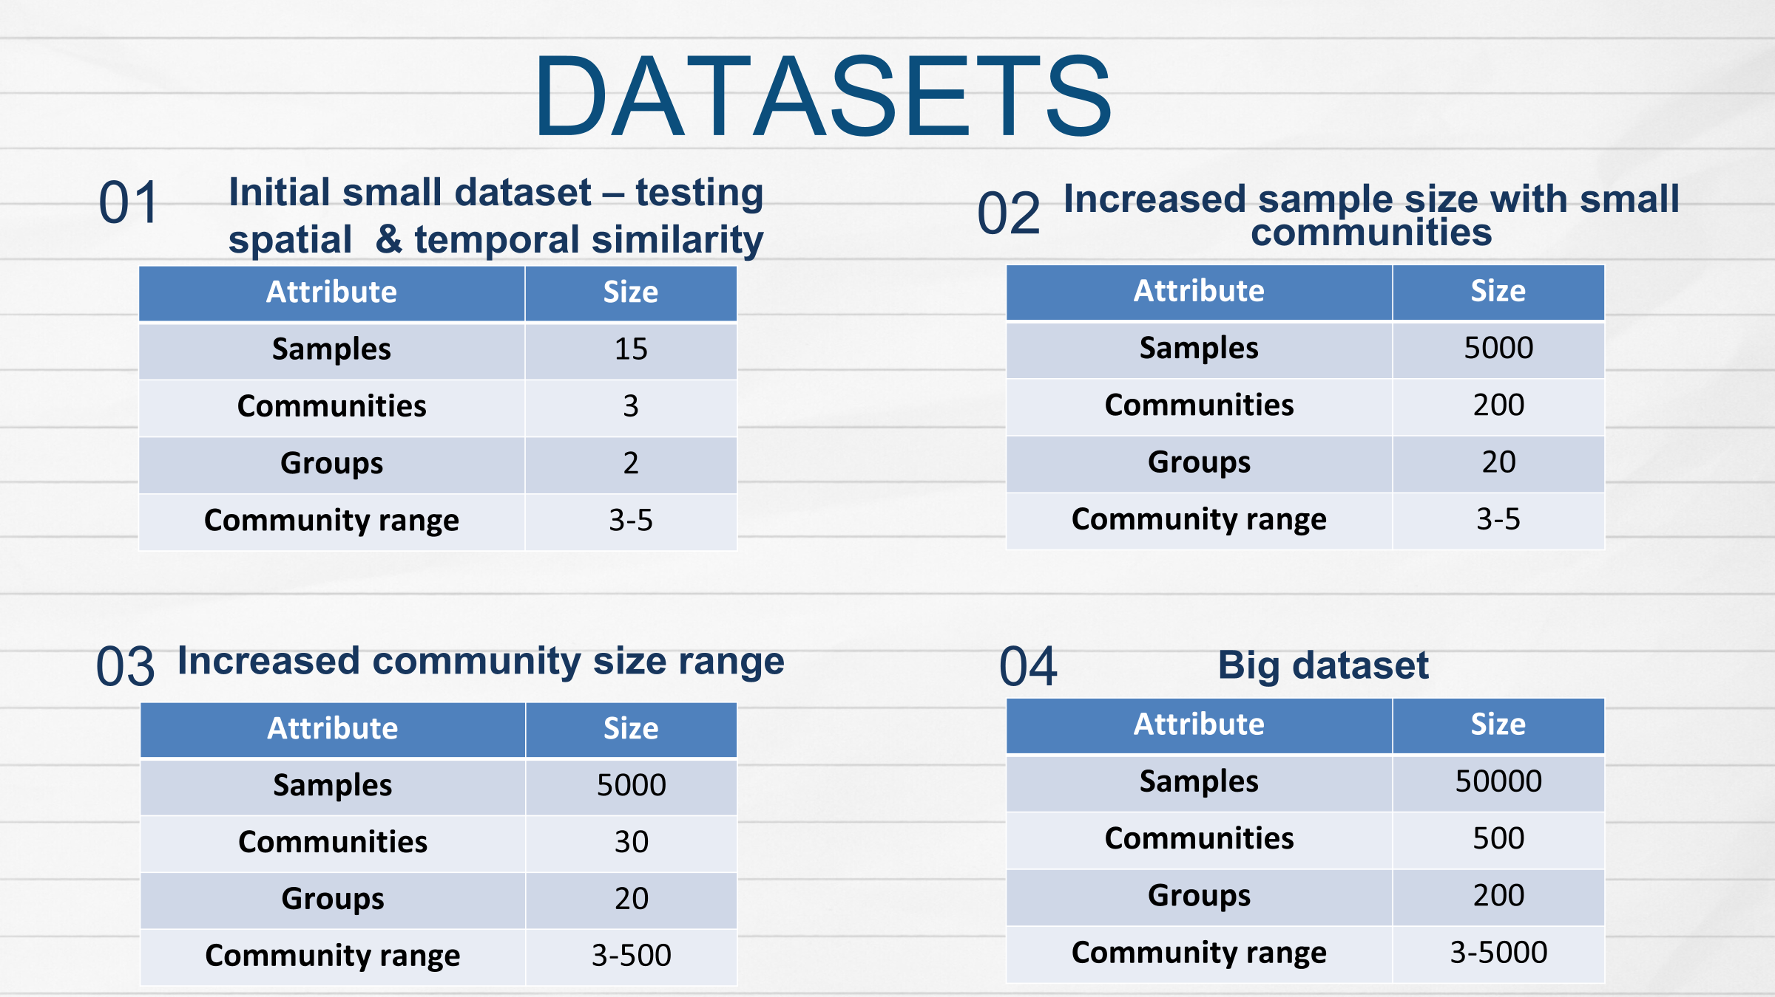
Notes:
We want to test our implementation on different aspects so we generated the following:
- First, we created a few toy example datasets that enabled us to check the spatial similarity, then the temporal similarity, and finally both of them combined
- When our selected approach did what it was intended to do, we selected the following attributes to test our solution.
- number of samples
- number of groups
- And the range size of each community
- For each dataset, we plan to measure the time, memory, and CPU usage that our solution use

Slide 3






TECHNOLOGIES USED
Notes:
In this project, we will use the following tools: Our solution is written in Python and uses popular libraries to work with Spark like Graphframes
In order to collaborate we used google colab

Slide 4

Extract similar groups
SOLUTION GENERAL STEPS
Step 1
Step 2
Generate
datasets
Create preprocessing pipeline
Step 4
Step 3
Extract similar groups
Performance
evaluation
Notes:
After generating the datasets, we created our preprocessing pipeline as follows:
Step 2:
We converted the start and end times of the calls into duration in minutes
then we created nodes – representing clients, and edges representing calls between two clients. The weight on the edges denotes the duration of the call
Using the graphframes library we created graphs for community detection. This method returned a unique id for each community
In addition, we added aggregation metrics such as unique clients in each community, mean duration, median, etc
Step 3:
Once we identified different communities, we calculate their sizes and we plan to compare those that are similar in size
Step 4:
Given our selected solution we will evaluate using the prementioned datasets, now will dive into the similarity score we selected
We will monitor the following metrics: CPU, memory and execution time our solution

Slide 5
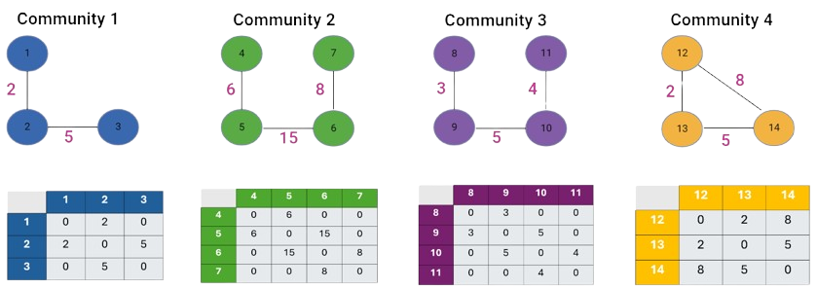
ADJACENCY MATRIX - TOY EXAMPLE
Notes:
In this example, we see 4 different communities which vary in size, number of calls, and duration of these calls

Slide 6
ADJACENCY MATRIX - TOY EXAMPLE
Notes:
To calculate the similarity between two communities we first needed to represent each graph as an adjacency matrix
For example, if you look at community 1 we have 3 nodes each representing a client. If a call between clients 2 and 3 lasts for 5 minutes then in the adjacency matrix cell (2,3) and (3,2) there will be a value of 5. Meaning the matrix represents the given community's spatial and temporal aspects.

Slide 7
ADJACENCY MATRIX - TOY EXAMPLE
Communities Pair | Similarity Score
1 + 2 | 0.90
Notes:
We see that the shape of Community 1 is contained in Community 2. The duration of Community 2 is 3 times the duration of Community 1
So we expect some spatial similarity but not so much in terms of time
However, given our method which is cosine similarity, it compares the connection patterns and calculates the angle between their vector representation resulting in a score from 0 to 1.
Currently, the spatial aspects are taken more into consideration than the temporal ones therefore the similarity score we get is quite high
We are currently checking alternatives for the similarity score that still uses the adjacency matrix – one potential method is DeltaCon.

Slide 8
ADJACENCY MATRIX - TOY EXAMPLE
Communities Pair | Similarity Score
2 + 3 | 0.98
Notes:
* Here we see a similar problem when the shape is the same, but the temporal values are different.
* So the current similarity score we get of 0.98 is inaccurate

Slide 9
ADJACENCY MATRIX - TOY EXAMPLE
Communities Pair | Similarity Score
1 + 4 | 0.50
Notes:
Skip this is we don’t have time
If we do:
* Here the shape is similar but community 4 has one more edge than community 1.
* However the similarity score is significantly lower than intuitively expected, since the duration is similar and there is just one extra interaction in community 4.

Slide 10
ADJACENCY MATRIX - TOY EXAMPLE
Communities Pair | Similarity Score
1 + 2 | 0.90
1 + 3 | 0.81
1 + 4 | 0.56
2 + 3 | 0.98
2 + 4 | 0.50
3 + 4 | 0.45
With 0.8 cutoff
threshold
Notes:
After we calculate all the similarity scores, we set up a cutoff threshold to categorize our groups.
The threshold determines the communities that form a group. So in this case, all the communities with a similarity score above 0.8 are considered a group.
Given the threshold of 0.8, we get two groups: one is marked in the red rectangle and the other in blue.
The threshold will be determined with hyperparameter selection

Slide 11

THANK
YOU FOR LISTENING!

